Slide 1
CS 6476 Project 1
Karan Sarkar
ksarkar9@gatech.edu
ksarkar9
903569592

Slide 2
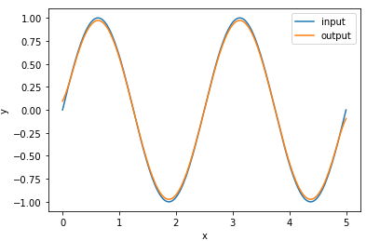
Part 1: 1D Filter
<insert visualization of the low-pass filter from proj1.ipynb here>

Slide 3
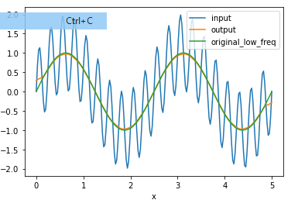
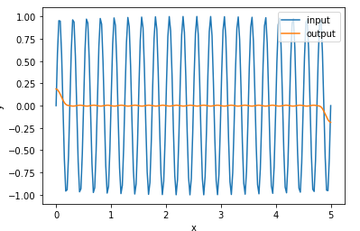
Part 1: 1D Filter
<insert visualization of filtered combined signal from proj1.ipynb here>
<insert visualization of the low-pass filter from proj1.ipynb here>

Slide 4
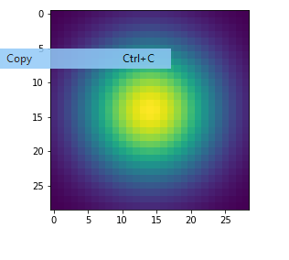
Part 2: Image Filtering
<insert visualization of the 2D Gaussian kernel from proj1.ipynb here>
<Describe your implementation of my_imfilter() in words.>
I calculated each cell of the filtered image separately. I padded the signal with zeros so avoid out of bounds errors. Each cell was calculated by a dot product of the filter and a subset selection of the padded signal.

Slide 5
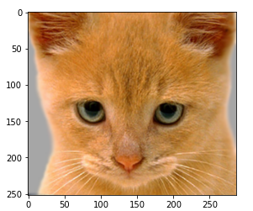
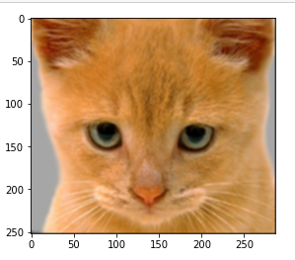
Part 2: Image filtering
Identity filter
<insert the results from proj1_test_filtering.ipynb using 1b_cat.bmp with the identity filter here>
Small blur with a box filter
<insert the results from proj1_test_filtering.ipynb using 1b_cat.bmp with the box filter here>

Slide 6
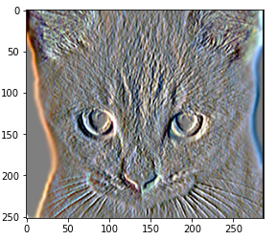
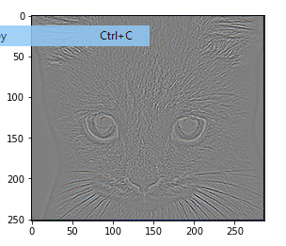
Part 2: Image filtering
Sobel filter
<insert the results from proj1_test_filtering.ipynb using 1b_cat.bmp with the Sobel filter here>
Discrete Laplacian filter
<insert the results from proj1_test_filtering.ipynb using 1b_cat.bmp with the discrete Laplacian filter here>

Slide 7
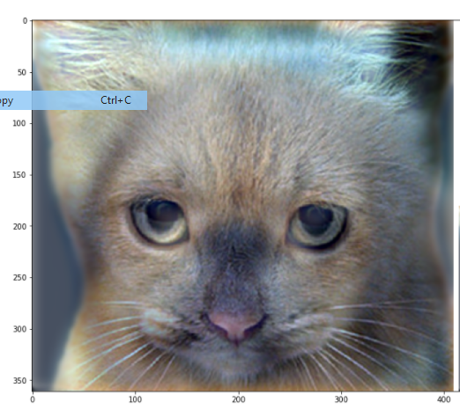
Part 2: Hybrid images manually using Pytorch
<Describe your implementation of create_hybrid_image() here.>
I used the 2d gaussian kernel to make low pass filters of both image1 and image2. Then, I subtracted the low frequency image2 from image2 to get the high frequency image2. Lastly, I added the low frequency image1 to high frequency image2
Cat + Dog
<insert your hybrid image here>
Cutoff frequency: 7

Slide 8
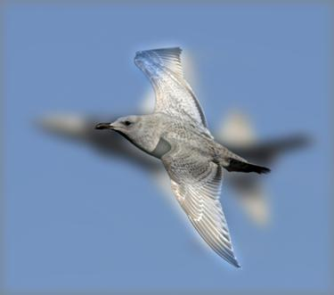
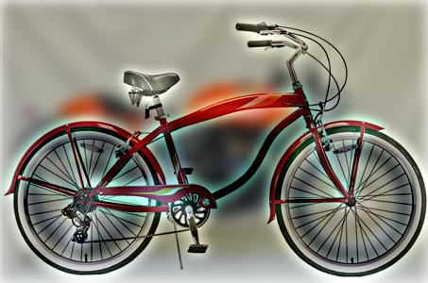
Part 2: Hybrid images manually using Pytorch
Motorcycle + Bicycle
<insert your hybrid image here>
Cutoff frequency: 7
Plane + Bird
<insert your hybrid image here>
Cutoff frequency: 7

Slide 9
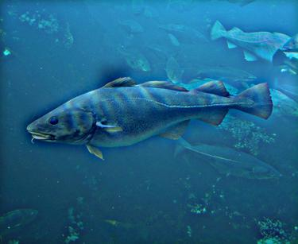
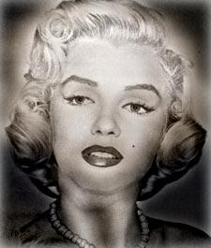
Part 2: Hybrid images manually using Pytorch
Einstein + Marilyn
<insert your hybrid image here>
Cutoff frequency: 7
Submarine + Fish
<insert your hybrid image here>
Cutoff frequency: 7

Slide 10
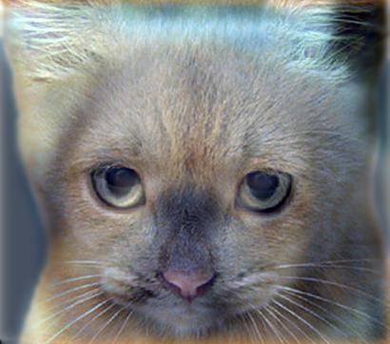
Part 3: Hybrid images with PyTorch operators
Cat + Dog
<insert your hybrid image here>
Motorcycle + Bicycle
<insert your hybrid image here>

Slide 11
Part 3: Hybrid images with PyTorch operators
Plane + Bird
<insert your hybrid image here>
Einstein + Marilyn
<insert your hybrid image here>

Slide 12
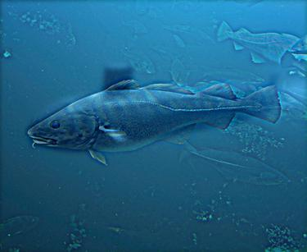
Part 3: Hybrid images with PyTorch operators
Submarine + Fish
<insert your hybrid image here>
Part 2 vs. Part 3
<Compare the run-times of Parts 2 and 3 here, as calculated in proj1.ipynb. What can you say about the two methods?>
Part 2 took 36 seconds. Part 3 took 3 seconds. Using built in Pytorch operations was much faster.

Slide 13
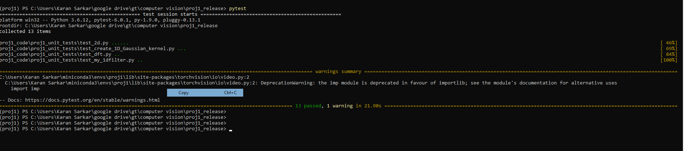
Tests
<Provide a screenshot of the results when you run `pytest tests` on your final code implementation (note: we will re-run these tests).>

Slide 14
Conclusions
Pairs: This question must be answered individually
I learned how allowing more low frequency of an image through creates the general outline of an image. The high frequency creates the detail.

Slide 15
Extra Credit

Slide 16
Image Filtering using DFT
<insert visualization of the DFT filtered 6a_dog.bmp and 6b_cat.bmp from proj1.ipynb here>
Describe your implementation in words.

Slide 17
Add some cool hybrid images!

